Slide 1


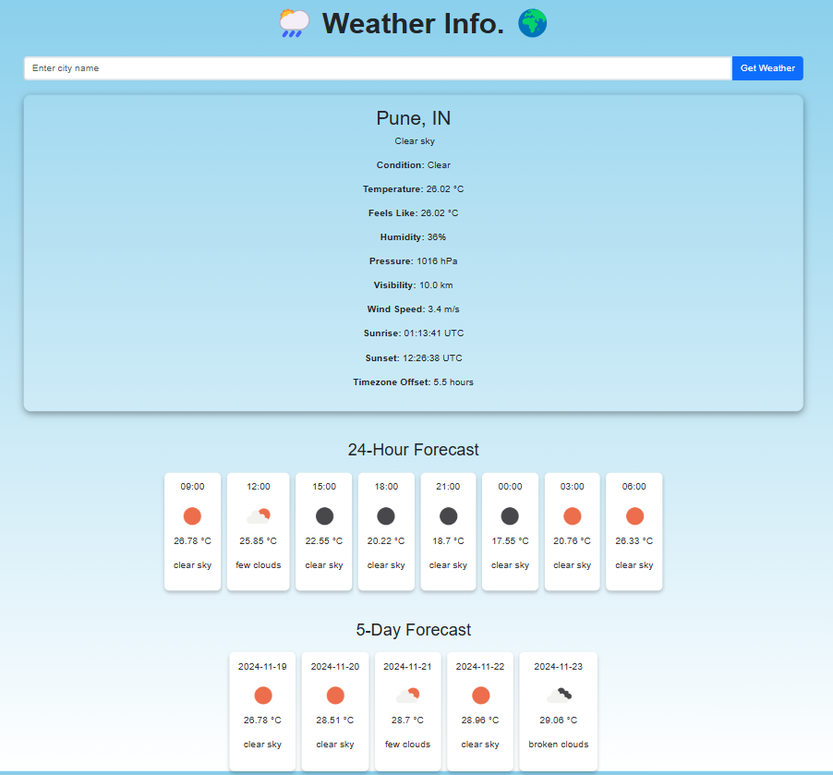
Weather Webpage Project

Slide 2



User Interface
Place your screenshot here

Slide 3
Overview
The Weather Webpage project is a dynamic and interactive platform designed to provide real-time weather updates for any location. Using a combination of technologies like HTML, CSS, JavaScript, and Python, the project integrates data from the OpenWeatherMap API to display detailed weather metrics, including current conditions, 24-hour forecasts, 5-day predictions, time zones, cloud cover, and chances of rain.
Enhanced with a modern UI/UX design, the webpage incorporates intuitive graphics, animations, and responsive layouts to ensure accessibility and engagement across devices. This project serves as an excellent tool for understanding web development, API integration, and user experience design while providing practical utility for users seeking accurate and detailed weather information.

Slide 4
Weather Details
Temperature
File Like
Wind Speed
Humidity
Pressure
Visibility
Condition
Timezone Offset

Slide 6
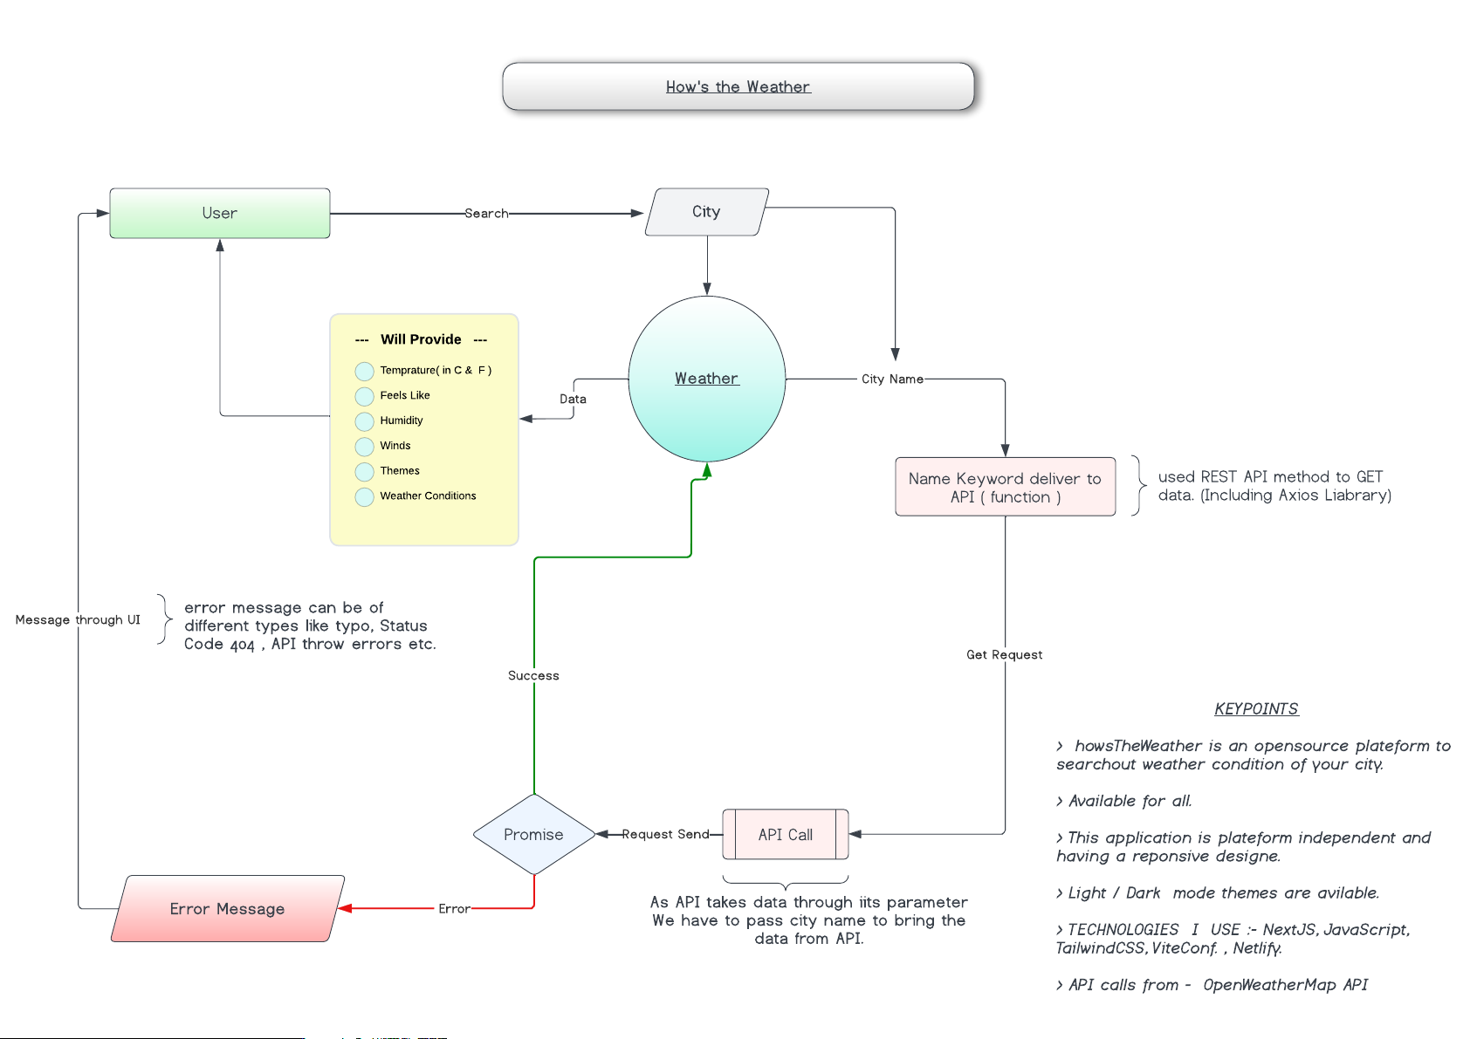
DETAILED WORKING PROCEDURE OF CODE

Slide 7
System Requirements
Hardware /Software | Hardware /Software Elements | Specification/Version
Hardware | Processor | Intel i3/i5/i7 or AMD
 | RAM | Min 4GB
 | HDD/SSD | Min 250 GB
Software | OS | Windows/ Linux/ Mac OS
Connectivity | Wi-Fi | Atleast 1 MBPS

Slide 8
Conclusion
The Weather Webpage project exemplifies the seamless integration of technology and design to deliver an engaging user experience. By combining HTML, CSS, JavaScript, Python, and APIs, the project provides real-time, accurate, and visually enriched weather data. Its intuitive interface, advanced graphical representation, and features like 24-hour and 5-day forecasts make it highly user-centric and functional.
This project not only enhances web development and programming skills but also sets a strong foundation for future enhancements such as AI-driven weather predictions, personalized alerts, and global accessibility features. It stands as a testament to the potential of technology in simplifying everyday tasks, offering users a reliable and efficient weather information platform

Slide 9







OUR TEAM
Harshit Singh
Working at Frontend
Sanjay Kumar
Working at Backend
Saurav Kumar Prasad
UI/UX Designer
Gaurav Kumar Prasad Testing and Deployment

Slide 10


THANK YOU
Do you have any questions?
sanjay.kumar@rungta.edu.in
+91 9065229836
CREDITS: This presentation template was created by Sanjay,
including icons by Harshit, and infographics & images by Saurav And Gaurav

